Slide 1
Digital communication
Lab-3
B.Tech II CS
(A+B)

Slide 2
Aim
To study amplitude modulated (AM) technique, modulation-index (m), draw waveforms, spectra and trapezoidal display. Illustrate the observed AM signals for double sideband with and without carrier by changing m as: m>1, m<1 and m=1 and draw it.

Slide 3
amplitude modulation
Process of changing the amplitude of high frequency sinusoid carrier signal in proportion with the instantaneous value of modulating signal.
Modulating Signal: Information signal or message signal or intelligence or baseband signal (Before modulation).
Band-pass (After Modulation).

Slide 4
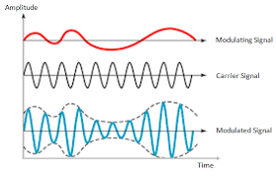
AM Wave

Slide 5
Modulation Index
The modulation index of a modulation scheme describes by how much the modulated variable of the carrier signal varies around its unmodulated level.
In AM, it is measure of extent of amplitude variation about an unmodulated carrier wave.
Ratio of amplitudes of modulating signal to the carrier signal.

Slide 6
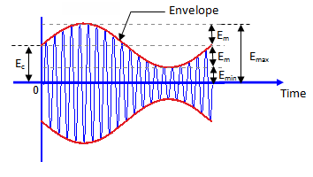
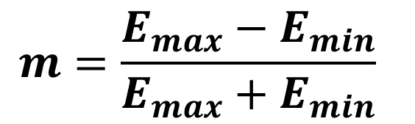
AM wave for calculating modulation Index
$$m=\frac{E_{max}−E_{min}}{E_{max}+E_{min}}$$

Slide 7
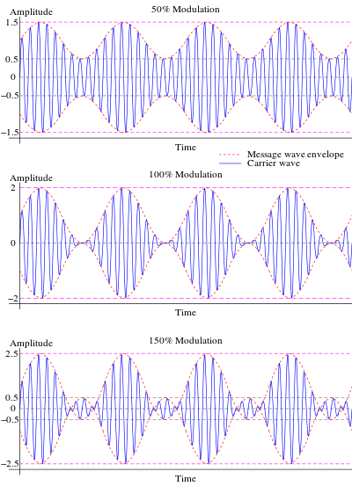
AM Envelope for different values of ‘m’

Slide 8
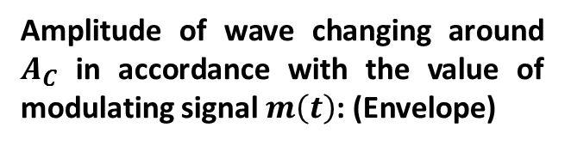
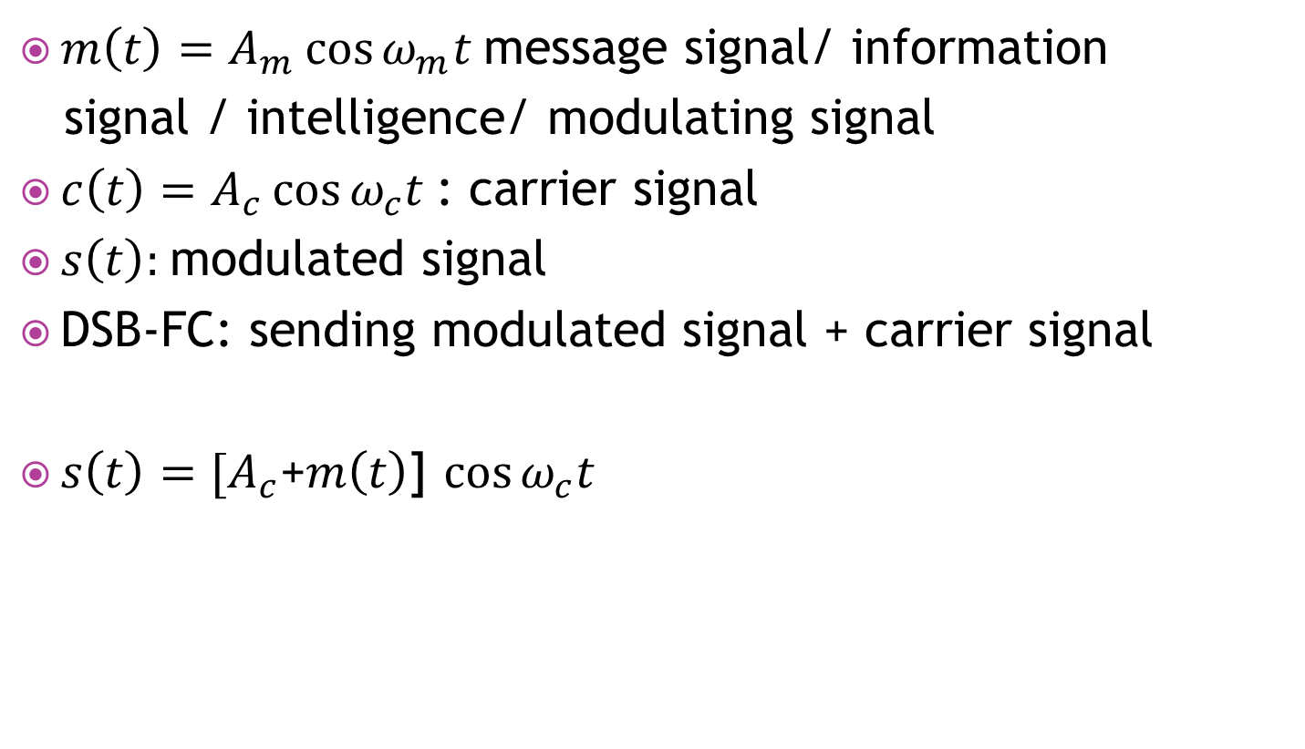
DSB-FC/AM/Conventional AM
$m\left(t\right)=A_{m}\cos{ω_{m}t}$message signal/ information
signal / intelligence/ modulating signal
$c\left(t\right)=A_{c}\cos{ω_{c}t}$: carrier signal
$s\left(t\right):$modulated signal
DSB-FC: sending modulated signal + carrier signal
$s\left(t\right)=[A_{c}$+$m\left(t\right)$] $\cos{ω_{c}t}$
Amplitude of wave changing around $A_{C}$ in accordance with the value of modulating signal $m\left(t\right)$: (Envelope)
Constant frequency

